Slide 1
Listen and draw
The teacher will carefully describe a picture which you have to draw.

Slide 2
Teacher notes
The students cannot see the pictures.
They need a sheet of A4 paper.
Supply any specialist vocabulary in advance.
They may or may not use colour.
Reveal the picture at the end.
Follow-up could include students describing the picture to a partner.
Images: pixabay.com

Slide 3
Vocabulaire utile
en haut de la page – at the top of the page
en bas de la page – at the bottom of the page
à gauche (de) – on the left (of)
à droite (de) – on the right (of)
au centre de la page – in the centre of the page
dans le coin – in the corner
à côté de – next to
au premier plan – in the foreground

Slide 4
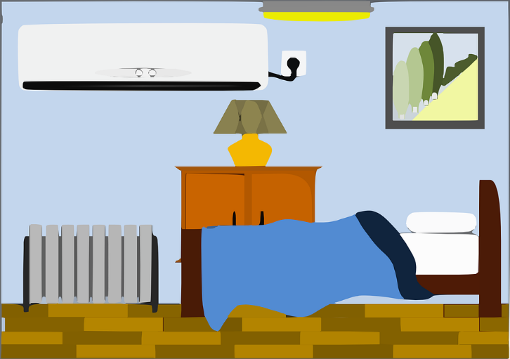

Slide 5
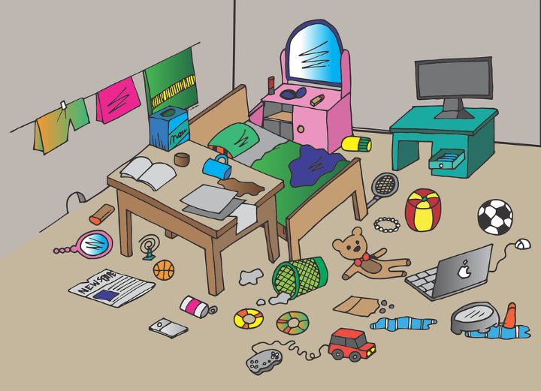

Slide 9
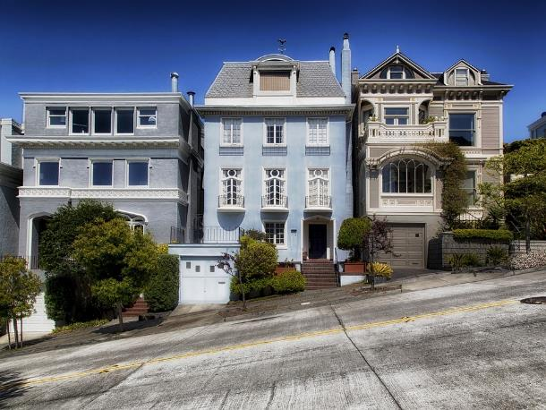

Slide 10
