Slide 1
Le juste prix!
Images: pixabay.com
© frenchteacher.net 2019

Slide 2
Teacher’s instructions
Invite 4 students to the front. Display a picture, describe it using language the class knows (build in repetition and emphasise key target language). The rest of the class listens.
Each student must guess the price. The winner stays up, the other 3 return to their seats to be replaced.
The rest of the class can jot down on paper or mini-whiteboard their own guess for interest.
Move on to the next picture. Prices are given on the subsequent slide.
Images are from pixabay.com for copyright reasons and prices are my guess!
You may want to quickly revise numbers before starting
Fee free to add or replace with your own pictures

Slide 3
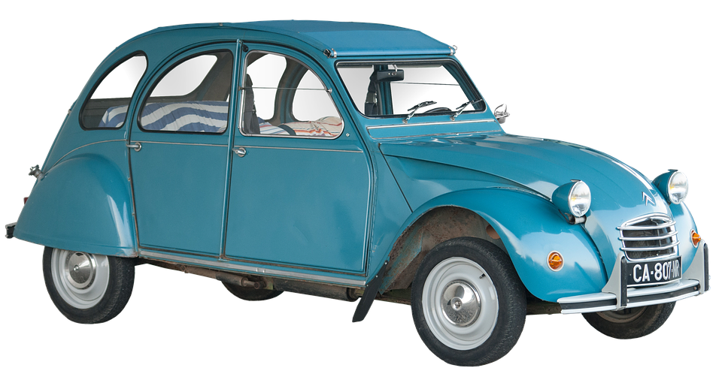

Slide 4
10,000 €

Slide 5
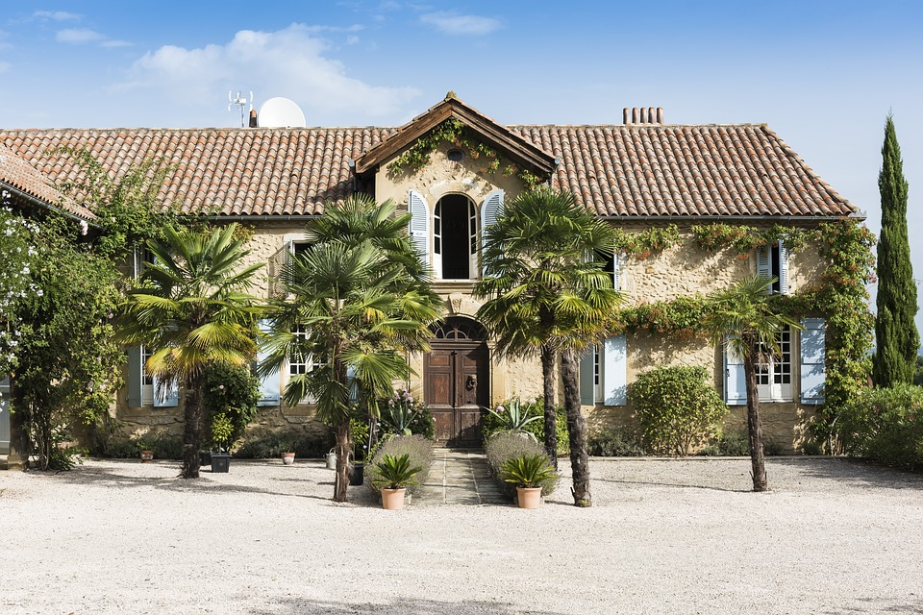

Slide 6
475 000 €

Slide 8
450 €

Slide 10
15 €

Slide 11
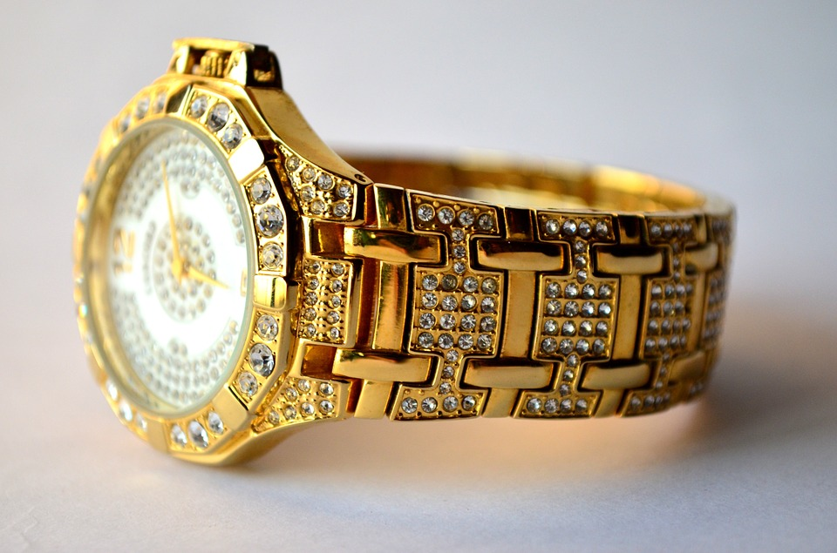

Slide 12
35,000 €

Slide 14
500 €

Slide 15
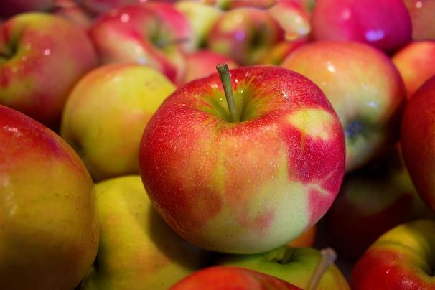
1 kg

Slide 16
3 €

Slide 17
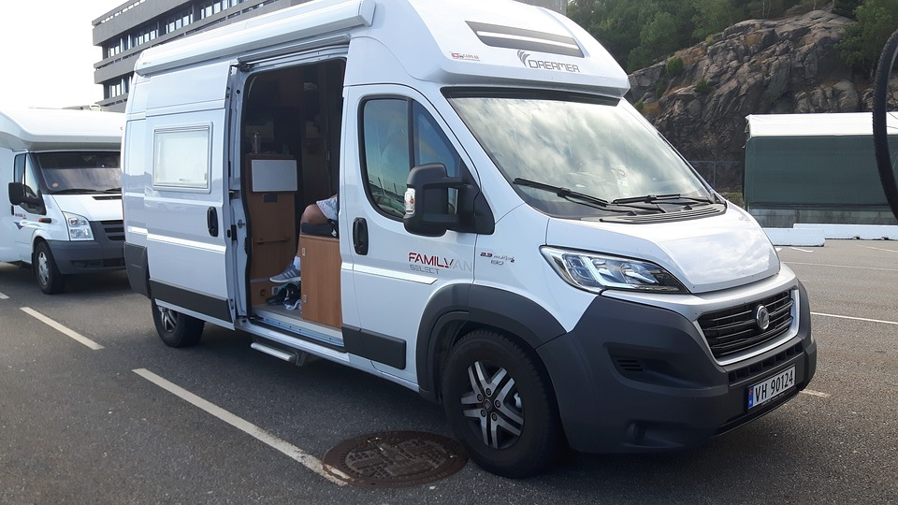

Slide 18
50,000 €

Slide 19
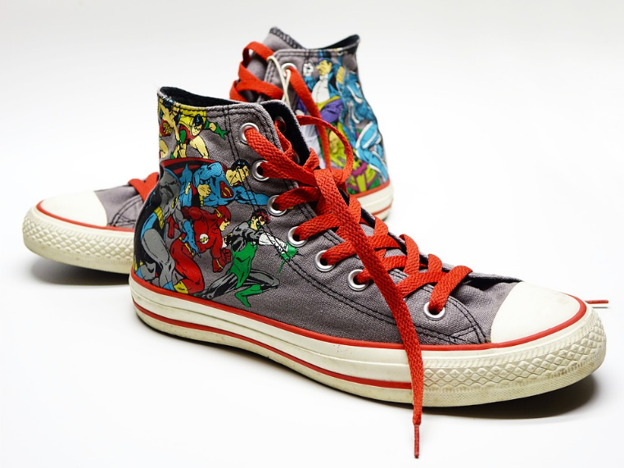

Slide 20
75 €

Slide 21
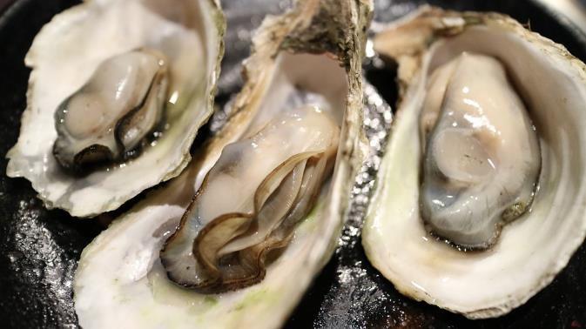
12

Slide 22
15 €

Slide 24
150 €

Slide 25
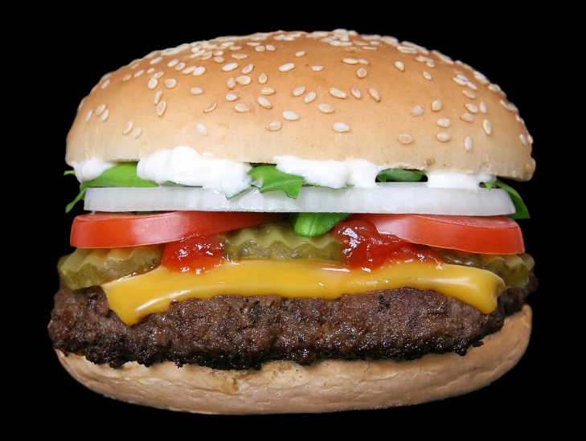

Slide 26
4.75 €

Slide 27
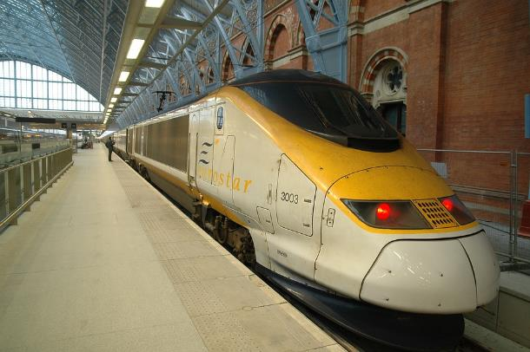
Londres à Paris 2ième classe

Slide 28
80 €

