Slide 1
Quels animaux préfères-tu?
Images: pixabay

Slide 2
Teacher instructions
Teach and practise 12 animals as displayed on the next slide. *
Provide each student with a written list of the animals (with translations if needed – see the last slide. Alternatively (maybe better!), get the class to copy down the list on a piece of paper.
When you think the class is ready, tell students to mill around and ask their classmates which three animals from a list they prefer.
Students then sit down and add up their scores.
Ask the class what they found, write up some scores on the board and decide what the three most popular animals are. Nothing too scientific!
Four question forms exist – take your pick:
“Quels animaux préfères-tu?” “Tu préfères quels animaux?”
“Quels animaux tu préfères?” “Quels animaux est-ce que tu préfères?”
*Note: remember that the h in hérisson is an ‘aspirate h’, so you don’t pronounce the s in les.

Slide 3
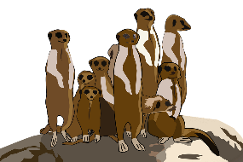
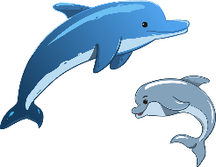
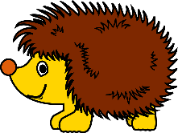
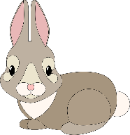
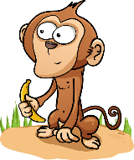
les dauphins | les chiens | les suricates | les éléphants
les chats | les baleines | Lles pandas | les hérissons wis
les manchots | les lapins s raisins | Lles singes | les loutres

Slide 4
Go around the class asking what THREE animals from the list below your classmates prefer. Mark a tick in the box against each answer you hear. Add up the scores at the end.
les dauphins |  | les pandas
les chiens |  | les hérissons
les suricates |  | les manchots
les éléphants |  | les lapins
les chats |  | les singes
les baleines |  | les loutres

