Slide 1
How to pronounce three French sounds

Slide 2
The ‘r’ sound, as in frère, mère, rat
Open you mouth quite wide
Make sure your tongue is resting at the bottom of your mouth
Try to make a gargling noise where the back of your tongue meets your uvula (the dangly thing at the back of your mouth)
Now add some voice to the sound, so it sounds a bit like a trill – remember to keep your mouth open wide
Now alternate between saying ‘ah’ and ‘ara’

Slide 3
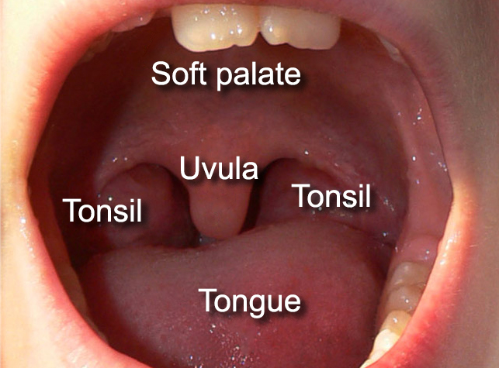

Slide 4
The ‘oo’ sound as in tout, nous, couleur
Make your lips small and round as if you are blowing out a candle
Feel your tongue curl back inside your mouth
Keep the lips there as you make a sound
Remember: don’t change the position of your lips at all as you make the sound – it has to sound ‘pure’

Slide 5
The ‘u’ sound as in une, lune, tortue
Make your lips small and round as if you are blowing out a candle
Feel the tip of your tongue behind your bottom front teeth
Imagine you are saying an ‘ee’ sound as you keep your lips rounded
Remember: don’t change the position of your lips at all as you make the sound – it has to sound ‘pure’

